Slide 1
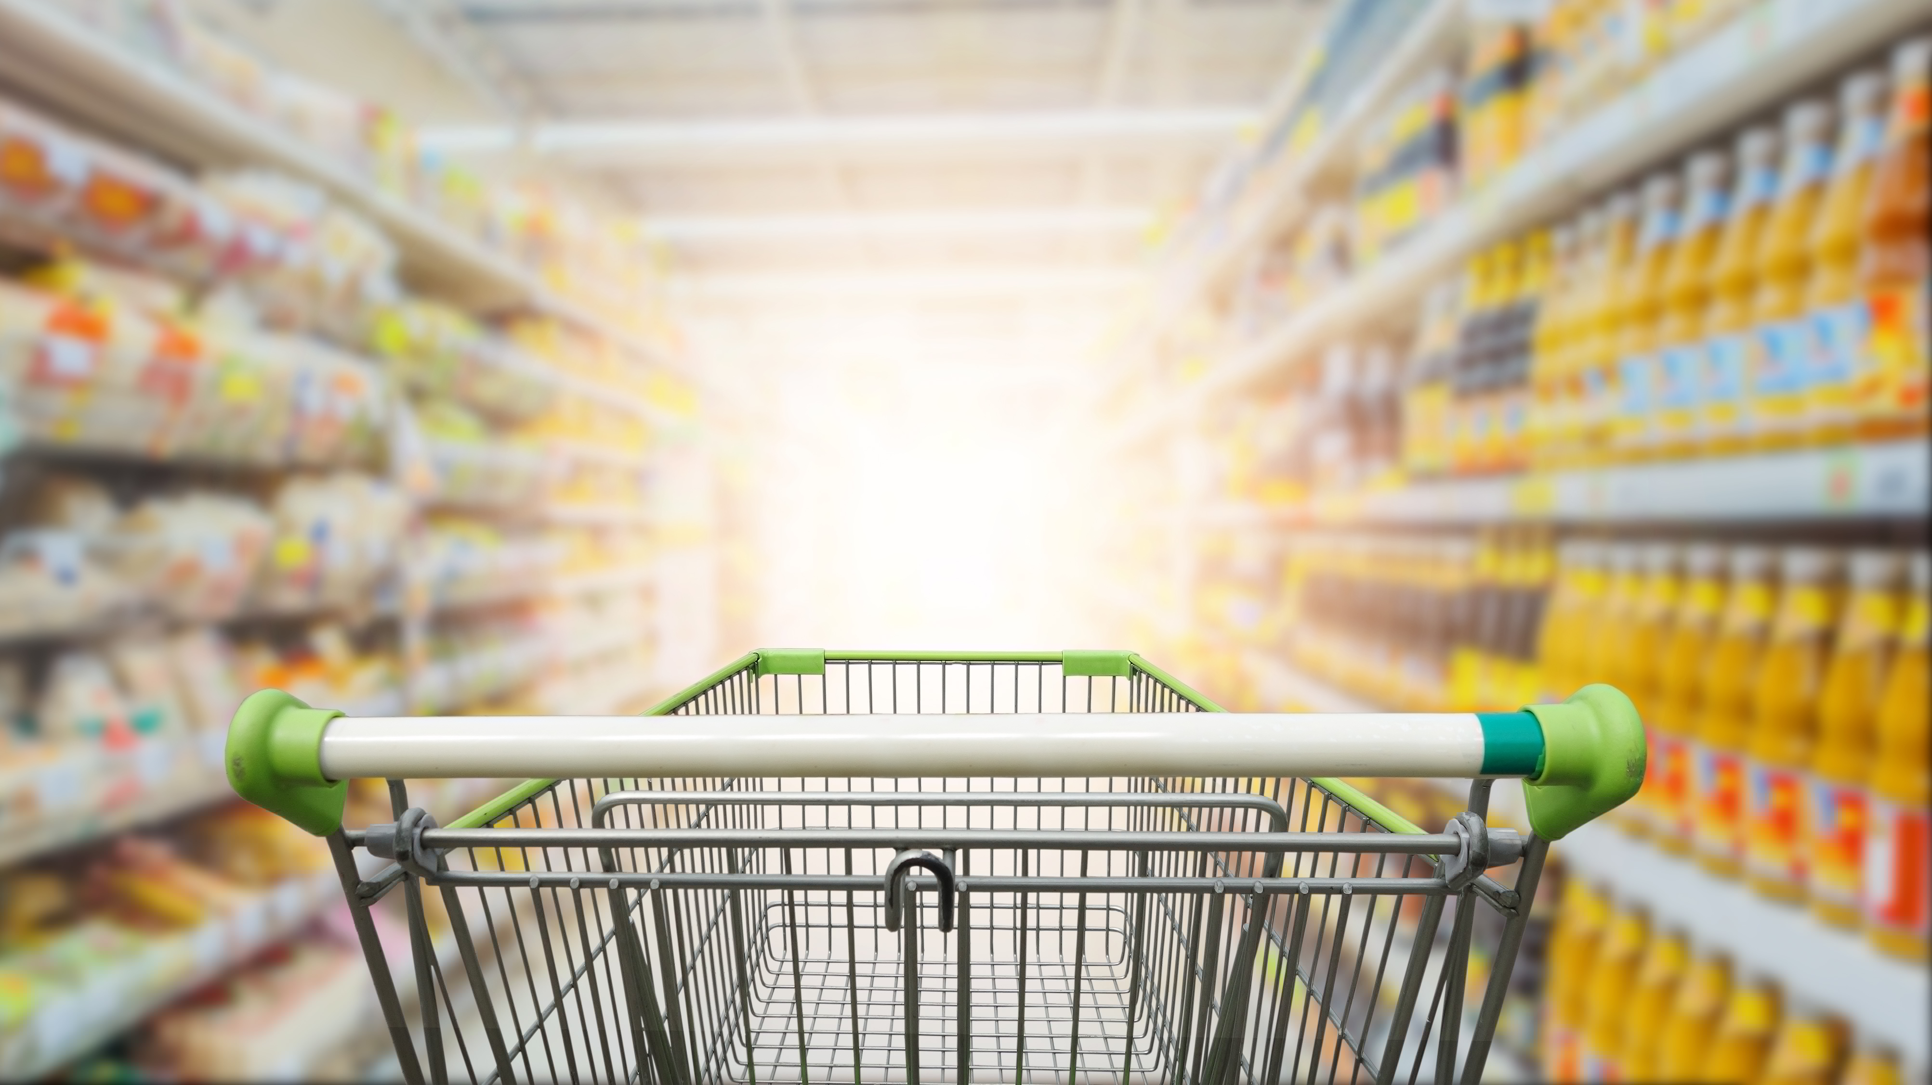
Local Food Economics Data Visualization Challenge
By: Elizabeth A. Fraysse, Yi Wang, and Fei Qin Ph.D.
Purdue University

Slide 2
Strength of Food and Chosen Variables
Economics | Social Support | Food Supply | Food Access
broad_16: Percent of population with access to fixed advanced telecom | snap_p: Percent of total people who participate in SNAP | d2c_per: Percent of local farms using direct-to-consumer channels | The number of different retailers/fast-food restaurants/SNAP-authorized stores per 1000 people (7 variables in total)
deposits: Bank deposits per capita at FDIC-insured institutions |  | interm_p: Percent of local farms using intermediate marketing channels
earning_fmp: Percentage of median income females earn compared to males |  | local_per: Percent of local farms participate in local food marketing channels
 |  | numberCSAs

Slide 3
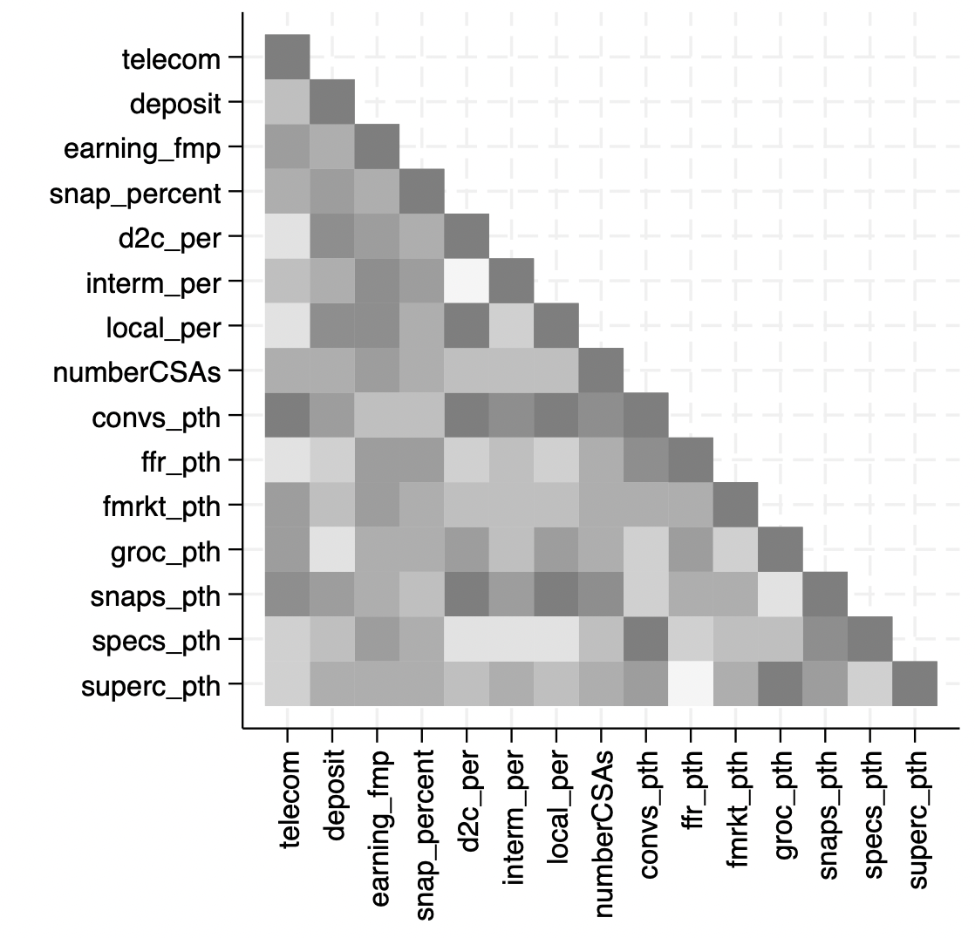
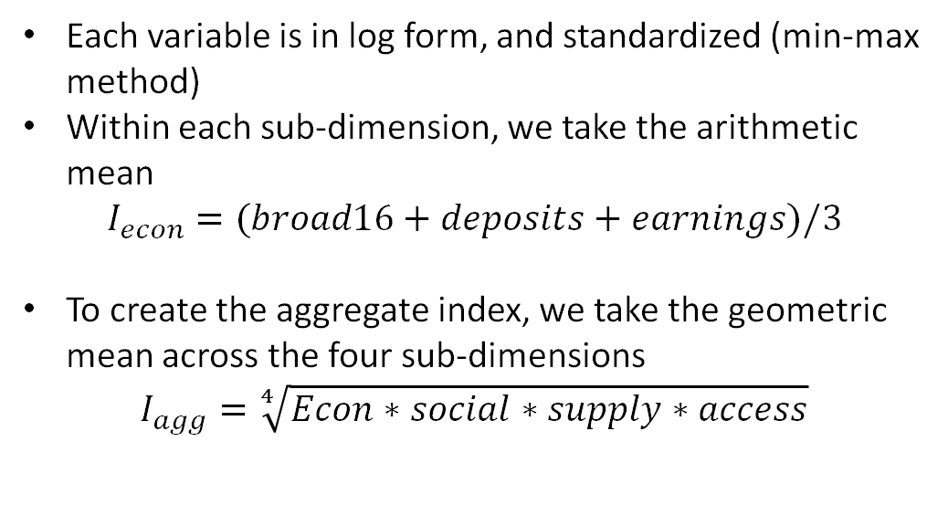
Index Construction
Each variable is in log form, and standardized (min-max method)
Within each sub-dimension, we take the arithmetic mean
$$I_{econ}=(broad16+deposits+earnings)/3$$
To create the aggregate index, we take the geometric mean across the four sub-dimensions
$$I_{agg}=\sqrt[4]{Econ∗social∗supply∗access}$$

Slide 4
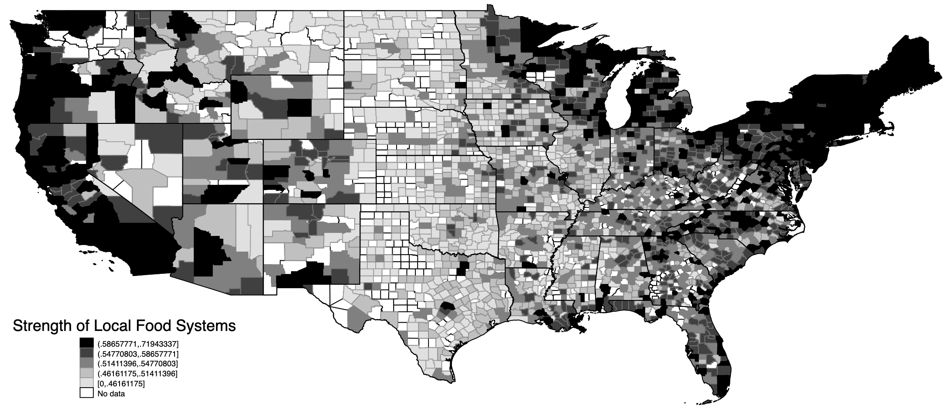
The Index Map

Slide 5
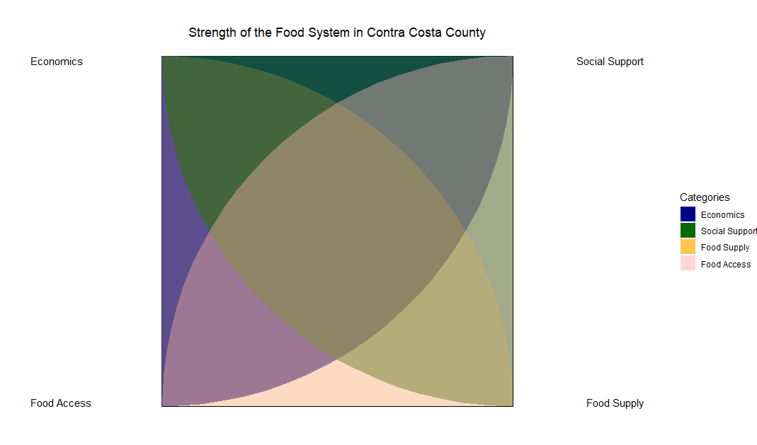
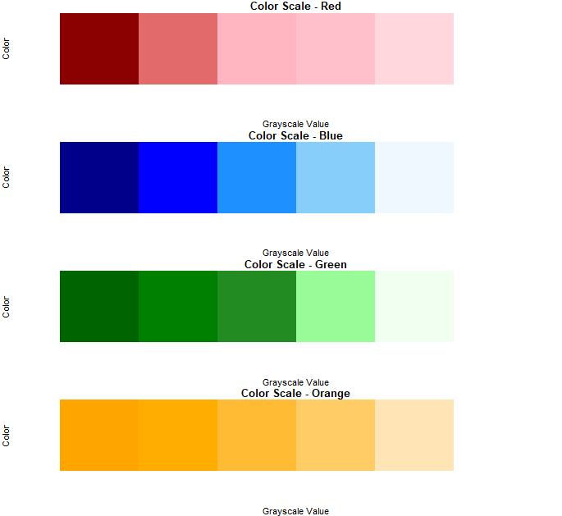

Slide 6
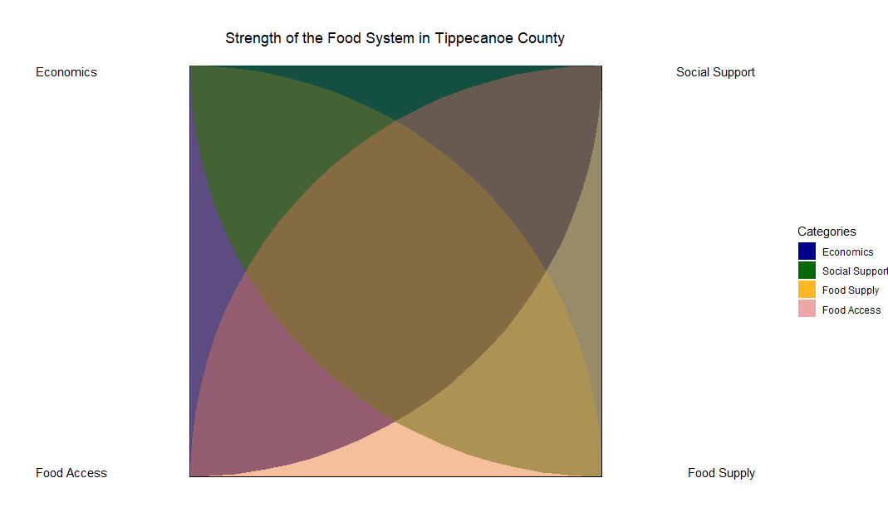
Econ
SS
Food Access
Econ
SS
Economics
Social Support
Food Supply
Food Access
Food Supply
Food Access
Food Supply

Slide 7

Thank you!

